Slide 1
Regional Pictures of Evolving Practice
Finlay Colville
Substance Use Worker
Alcohol and Drugs Action: Aberdeen

Slide 2
Needle Exchange IPED Statistics
Year | 2012/13 | 2013/14 | 2014/15 | 2015/16
Total Visits | 306 | 442 | 477 | 517
Total Clients | 177 | 228 | 266 | 285
Out of all of the clients who access our NX, 22% are IPED using clients.
IPED clients contributed towards 6.5% of total visits to our NX.

Slide 3
Dedicated IPED Worker
Staff training
Increasing awareness of our service
Referral to dedicated IPED worker

Slide 4
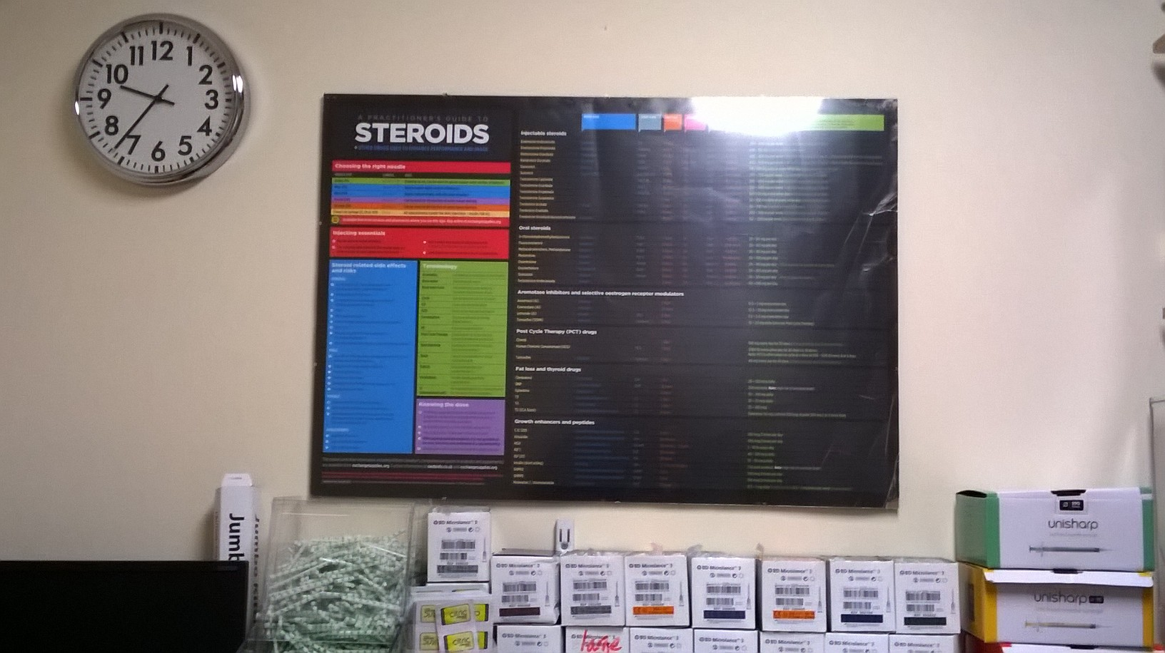
Dedicated IPED Worker
Addition of Materials

Slide 5
Next Steps
Dedicated service for IPED users
Volunteer engagement / peer support
Continued sharing of information and good practice.

Slide 6
Thank You
Finlay Colville
Email: fcolville@alcoholanddrugsaction.org.uk
Contact: 01224 577 120
Address: Alcohol and Drugs Action
7 Hadden St
Aberdeen AB11 6NU

