Slide 1
Improving quality of drug services in the NHS
Annette Dale-Perera
ADP ConsultancyUK, Lead consultant: UNODC international drug treatment quality standards and assurance project

Slide 2
Covering
Quality standards and assurance mechanisms in drug treatment
Personal reflections on attempts to improve quality in NHS drug services
Learning points on how quality assurance process can help create recovery orientated drug treatment services

Slide 3
Quality standards and assurance mechanisms in drug treatment
Growing number of national and international quality standards and assurance mechanisms for drug treatment
International
UNODC/WHO quality standards for the drug treatment of drug use disorders (2016) and international piloting of quality assurance mechanisms 2017 onwards
European quality standards for drug treatment EQUS (2016 and piloting 2017 onwards)
UK National systems
QuADS; Healthcare Commission/NTA; Care Quality Commission; Scotland “Quality Principles’
‘Commercial’ systems eg
International Standardisation Organisation (ISO) general quality assurance systems;
health and social care system eg CARF (Commission on Accreditation of Rehabilitation Facilities) with specialisms for drug in-patient treatment and residential rehabilitation

Slide 4
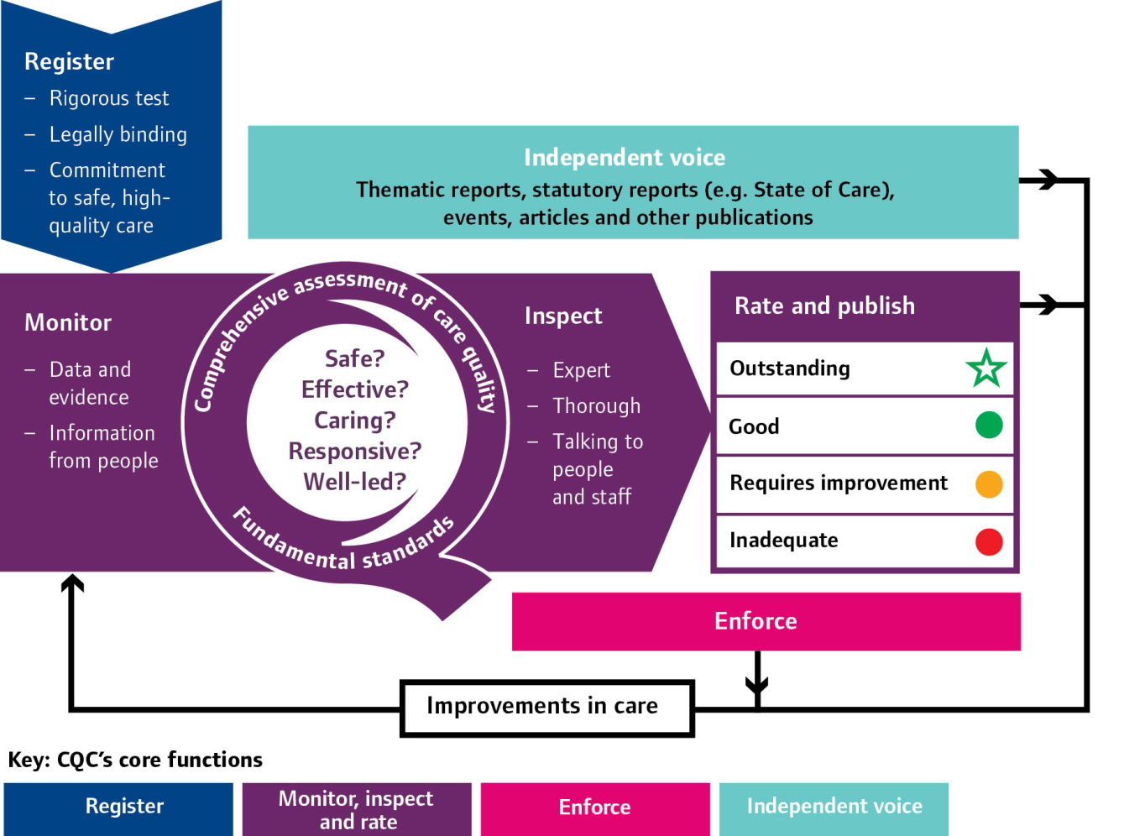
Care Quality Commission England
CQC regulate and inspect all health and social care including drug treatment
NICE tells us what evidence-based and cost effective treatment to provide

Slide 5
International examples of quality assurance
European Union (EU) new quality standards for drug treatment services EQUS
 | Interventions Level | Service Level | System Level
Structural quality | Setting | Resource | Legal & ethical
Process quality | Implementation | Procedures | Service co-operation
Outcome quality | Effectiveness | Effectiveness | Treatment coverage
Benchmark | Cost-benefit | Cost Utilization | Cost effectiveness

Slide 6
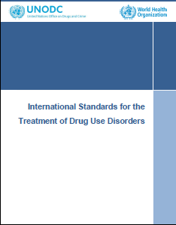
International examples of quality assurance
United Nations/World Health Organisation
System standards | Service standards
Strategic partnership | Core Management
Needs assessment | Core Care
3-5 year System plan | Patients rights & responsibility
Service funding in line with evidence | Intervention standards
Funders support system quality improvement | Setting standards
 | Target group standards

Slide 7
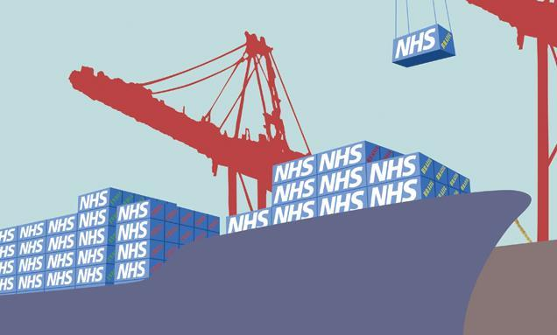
Personal reflections on attempts to improve quality in NHS drug services
NHS services have many strengths: we need them
NHS has good governance and a culture of quality assurance
NHS good at health – help
people build health recovery capital
BUT
Some NHS organisations can also be:
Bureaucratic
Risk averse
Slow to implement
Illness and disease focused
Professional interest group driven

Slide 8
Example 1: using quality assurance to implement evidence-based opioid substitution treatment
Annual audit inc prescribing practice in line with
Orange Guidelines
Audits: Prescribing data, case note audit & service user survey
Audit team of staff from 9 services: audit each other
Specific focus on
Supervised dispensing
Mean doses of methadone and buprenorphine
What regimens: maintenance or community detoxification
Results
Mean doses lower than recommended for maintenance
Unclear regimens (lots of ‘slow reduction’)
50% on supervised dispensing not visible link to ‘stability”

Slide 9
Example 1: Implementing evidence-based opioid substitution treatment: actions
Discuss AUDIT results In Clinical governance meetings and with clinicians/prescribers
Mean dose : clinicians said low doses were ‘client driven’. Second audit on lower dose clients - results that half were using opioids ‘on top’ – so slow reduction = poor practice for these service users.
Clinicians trained on Optimising OST (changing medication, increasing dose, supervision, psychosocial interventions)
Regimens: Clinical lead trained on OST maintenance in line with Guidelines OR community detox in 3 months.
Supervised dispensing: Clinical lead training and supervision to move to ‘take home’ if stable and not using on top.
Key messages
Regular clinical audit and working with clinicians was required to ensure fidelity to evidence-based prescribing

Slide 10
Example 2: Implementing recovery-oriented drug treatment in NHS services
Phase 1 2010/12
Review & feedback to staff: painful and challenging
New Leadership team: manager & lead clinician of each service
Quarterly KPI & outcome data to review quality & performance
Annual audit inc Service User Survey
Introduction of cognitive mapping
New Service user involvement strategy
Restructured services to increase efficiency & reduce unit costs 25%

Slide 11
Example 2: Phase 2: services…..following the publication of “Medications in Recovery’ 2012
Review of service model
Re-orientated of staff with a focus on outcomes and helping people gain recovery capital with training in cognitive mapping
‘experts by experience’ staff & peer volunteers in each service
Assessments revised to include assets
Service user involved in quality governance and service redesign
Service user help redesign recovery care plans to include “5 ways plans”
Service user treatment pathway posters

Slide 12
Example 2: learning points
1/4ly ‘Leadership team’ meetings helped.
Having TOP outcome data helped (Treatment Outcome Profile)
Psychologists helpful in modernising psycho-social interventions championed mutual aid & peer-led services
Employing experts by experience (EbyE) with criminal records in NHS took persistence – but then some became Trust stars
Some services/staff embraced change more than others. Not so well implemented where staff risk averse or nihilistic. Work with resistance: challenge prejudice against EbyE staff
Service User Reps monthly meetings with senior management team (over pizza), were helpful to feedback, devise projects and an annual conference.

Slide 13
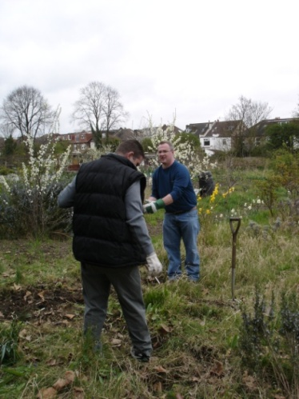
Example 2: learning points
Services became more vibrant, peer ‘meet & greet’, recovery cafes, mutual aid, social activities, new SU-led care plan format & allotments, and enabled development of a new peer-led charity

Slide 14
Conclusions
NHS has critical role to play in recovery orientated drug treatment
Champion high quality treatment including opioid substitution
It can champion helping service user build health recovery assets
Vaccinate Hep B, Treat Hep C and HIV
Reduce overdose rates: increase coverage of OST, increase Naloxone distribution, reduce smoking amongst heroin users
Re-orientation has been required in other countries:
Asset and deficit focus; service users as partners; helping service user build wider recovery capital, take a long term or extensive approach
Quality standards and quality assurance can help this process

