Slide 1
Drug Policy Through A Health Lens Rapid Evidence Review Elinor Dickie, MSc 26 July 2017

Slide 2
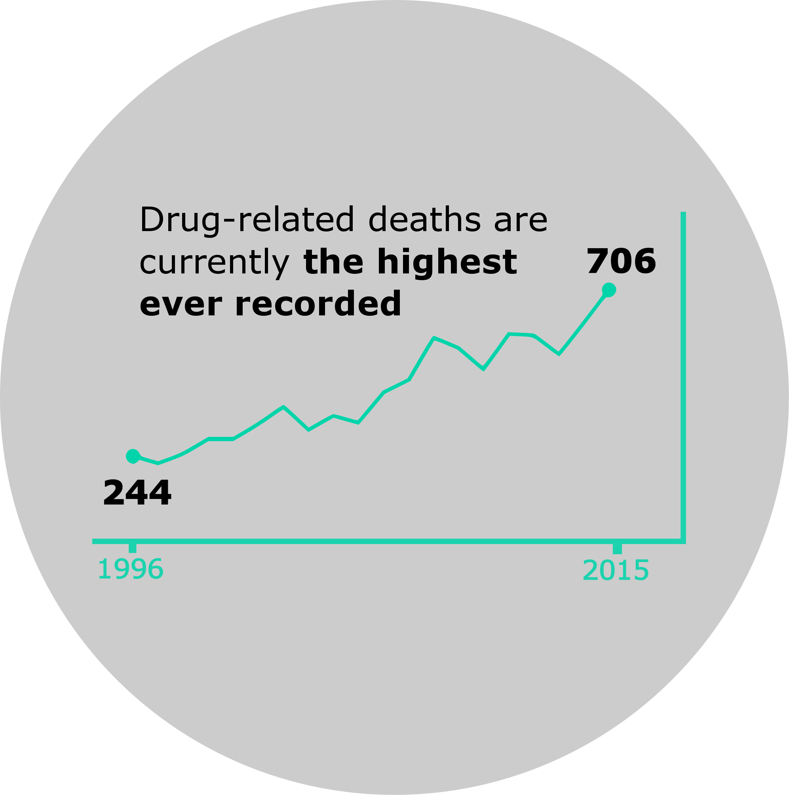
Key trends
drug-related deaths continue to increase ……
6% of adults had used one or more illicit drugs in last 12 months.
Since 2008/09
1.6
Percentage points
95% of 13 year olds and 81% of 15 year olds had never used drugs
Source: National Records of Scotland (2016), drug-related Deaths in Scotland in 2015
2009/10
2012/13
Still over 60,000 problem drug users.
Notes:
Drug use in the general population is falling and amongst young people remains low.
The level of problem drug use has not changed significantly in recent years, but again the age profile has changed. The estimated number of people under 35 with problem drug use has decreased, but the number over 35 has increased.
At the same time, drug-related deaths have been increasing, reaching a record high of 706 in 2015.
The increase in drug-related deaths is largely accounted for by increased deaths among over 35s. At the same time there has been a fall in the number of deaths of people aged under 25.
Sources:
Scottish Government, (2016), 2014/15 Scottish Crime and Justice Survey: Drug Use, Edinburgh: Scottish Government
Scottish Government (2016) Scottish Schools Adolescent Lifestyle and Substance Use Survey: Drug Use Report
ISD Scotland (October 2014) Estimating the National and Local Prevalence of Problem Drug Misuse in Scotland in 2012/13

Slide 3
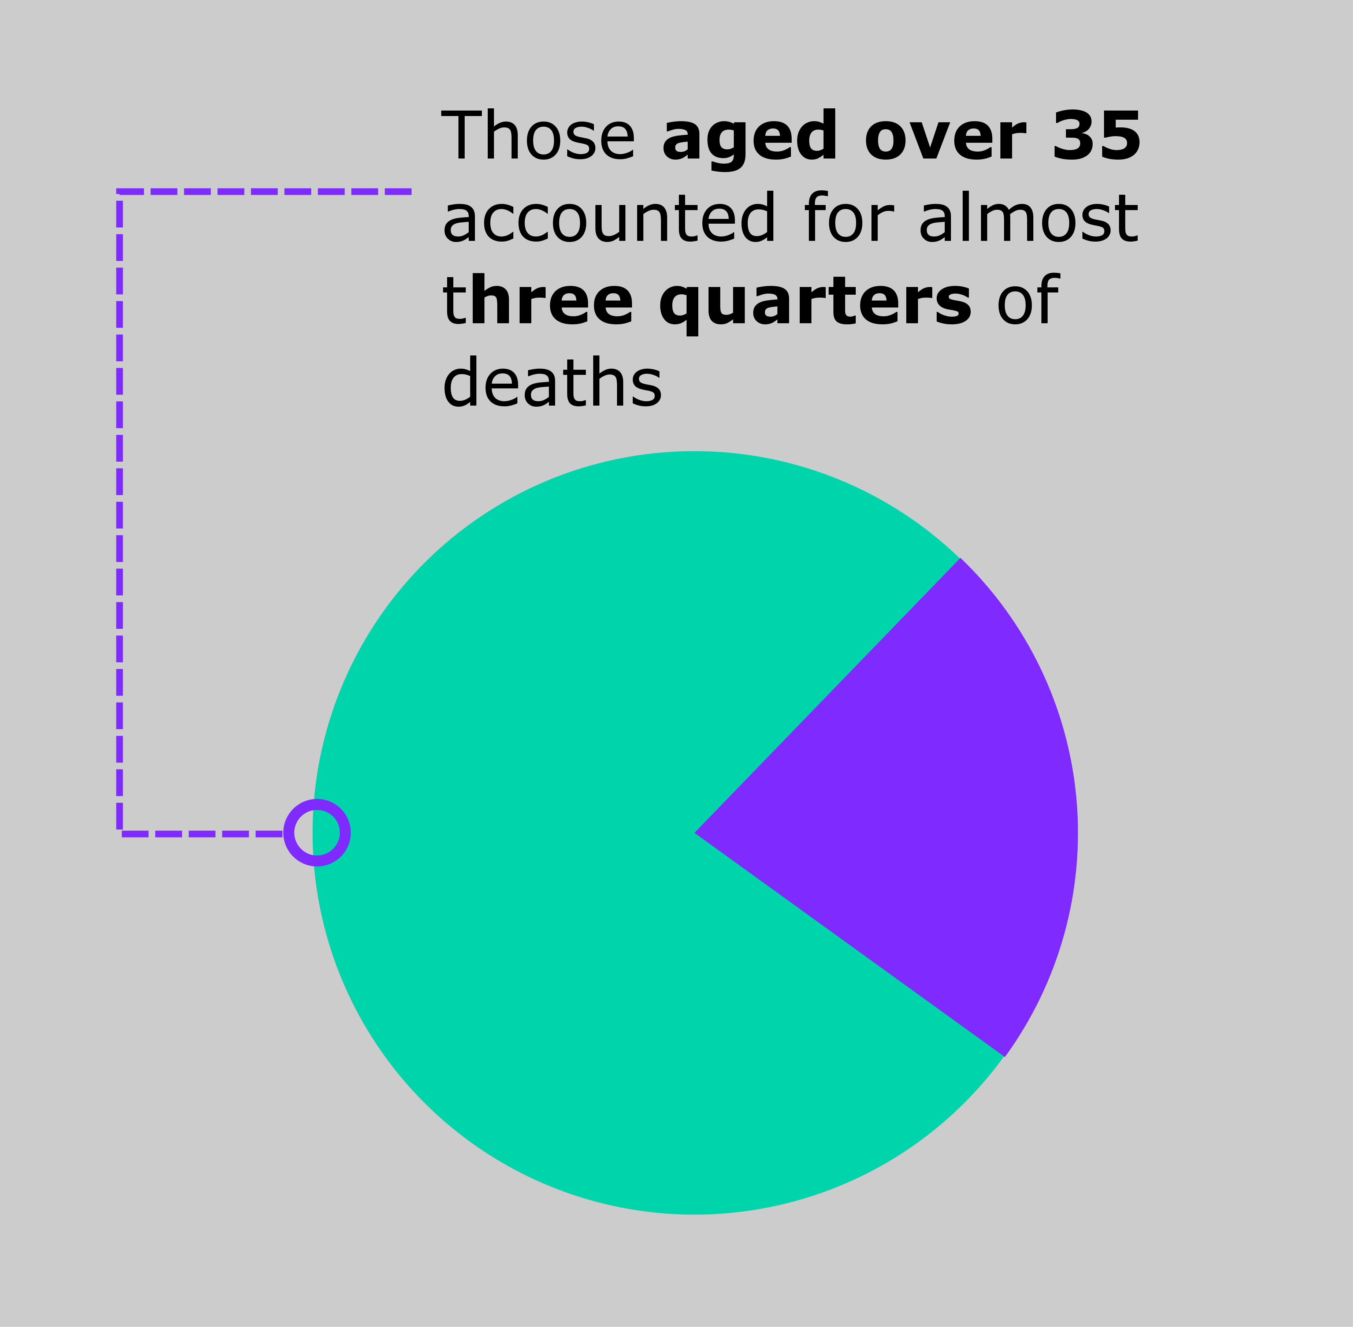
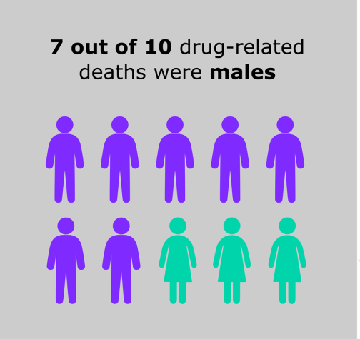
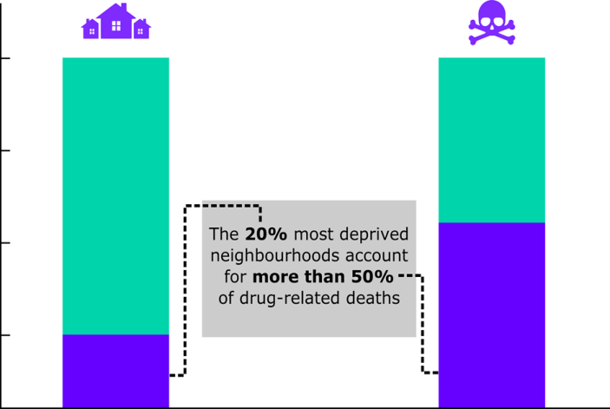
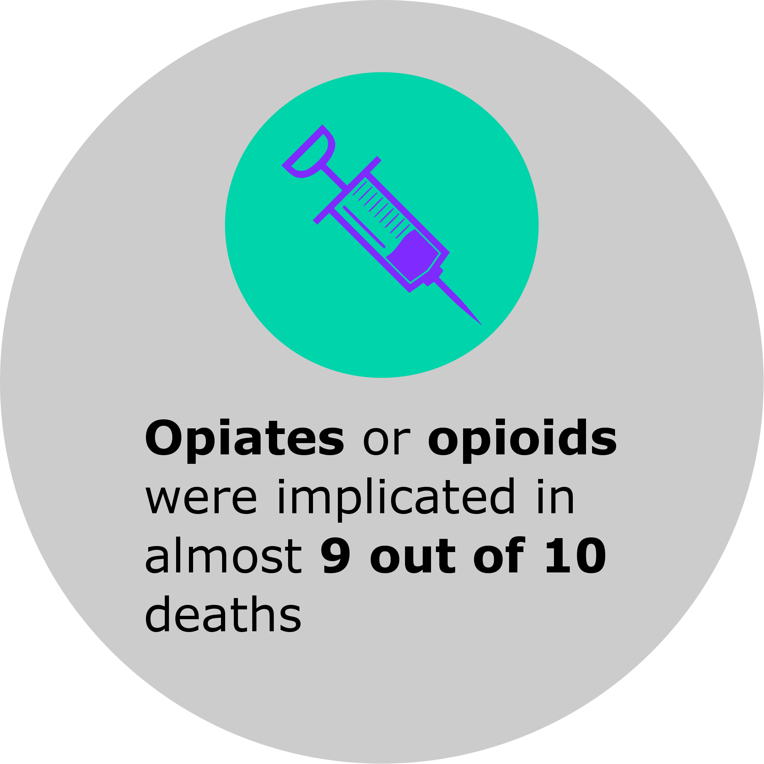
The Scale of the problem
Notes:
There were 706 drug-related deaths in Scotland in 2015. A 15% increase from 2014, and the highest ever recorded.
These deaths have wide societal impacts (e.g. on families, communities and the Scottish economy) and contribute to overall health inequalities in Scotland.
Males accounted for the majority (69%) of drug-related deaths in 2015.
Those aged 35 and over accounted for almost three quarters (73%) of deaths.
The majority (53%) of individuals lived in the 20% most deprived neighbourhoods.
In 2014, 310 children lost a parent or carer to a drug-related death.
Most drug-related deaths were of people who took more than one substance.
Opiates or opioids were implicated in almost 9 out of 10 (86%) deaths in 2015, and more than the previous highest ever number. Benzodiazepines were implicated in over a quarter (27%).
Sources:
ISD Scotland (March 2016) The National Drug-Related Deaths Database (Scotland) Report: Analysis of Deaths Occurring in 2014.
National Records of Scotland (2016), drug-related Deaths in Scotland in 2015

Slide 4
Risk factors for drug-related death
Notes:
We already know a lot about the risk factors and those who are most at risk of drug-related death and this is backed up by the literature. Risk factors include:
Injecting drug use, which carries a higher risk of death from overdose, as well as a high prevalence of BBV infection.
The risk of drug-related death is higher in individuals using drugs who were recently released from prison or hospital.
A correlation between deprivation (and associated unemployment and homelessness) and drug-related death.
Poly-drug use (particularly involving drugs with a sedative effect) and other risky behaviours (including smoking, chronic alcohol use, poor diet and lack of exercise).
Frequent entrance and exit from treatment. This demonstrates the importance of good recovery oriented practice which enables access to, and retention in, services.
Older age (and associated complex health and social care needs, isolation, mental health problems, chronic pain).
Being male, although the proportion of deaths accounted for by women has increased in recent years.

Slide 5
Rapid Evidence Review scope & process
Review question:
How can services keep people safe?
access to services
health and social needs
Literature search & synthesis
Limits
Summary of findings: Seek, Keep, Treat
Notes:
Search strategy informed by trends and risks, as well as articles and working with knowledge services
500 abstracts reviewed, 40 articles of possible relevance, 2015 limit – 8 included systematic reviews from last two years.
Absence of mention in this review summary does mean absence of relevance
Just limits of current task – working paper
To contribute to discussion, and ongoing work

Slide 6
Summary of findings: engagement and access to services
SEEK
Psychological and social barriers
Complex physical and mental health needs
Take Home
Naloxone
Key point
Intensive support to overcome barriers, meet needs and the provision of take-home naloxone can prevent deaths.

Slide 7
Summary of findings: characteristics of treatment and support
KEEP
First four weeks
in & out of
treatment
Which medications for whom
Psychosocial interventions
Contingency Management
Age-appropriate services
Key point
It is important for treatment approaches and services to be tailored, adapted and designed to meet individual needs.

Slide 8
Summary of findings: treatment benefits
TREAT
Opiate Substitution Treatment
Choice of Treatment
Harm reduction
Key point
The health of individuals with opiate dependence is safeguarded whilst in treatment

Slide 9
Gaps/ next steps
Older users – specific effective interventions
Social isolation
Effective components of psychosocial interventions
Justice settings
Relationship with BBVs & integrated care needs
Age-related drug interactions & physiological changes

Slide 10
Conclusion
Intensive support to overcome barriers and meet needs
Design services to improve access and keep people in treatment
Seek
Keep
Treat
Being in substitution treatment is protective against the risk of death
Work in progress…

Slide 11
Acknowledgements
Scottish Government Health Analytical Team
Colleagues at NHS Health Scotland
(Julie Arnot, Garth Reid, Emma Riches)
PADS Harms Sub-group
Thank you for listening.
elinor.dickie@nhs.net

