Slide 1
The epidemiology of IPED users attending IEP services in Scotland
Initial insights
Andrew McAuley & Norah Palmateer
SDF IPED conference
22nd March 2017

Slide 2
Background
Little known about IPED use in Scotland
Lack of data, literature
Historically ‘small’ population
Emerging public health threat?
New data (NEO / NESI / UAM / PHW)
Evidence of harms

Slide 3
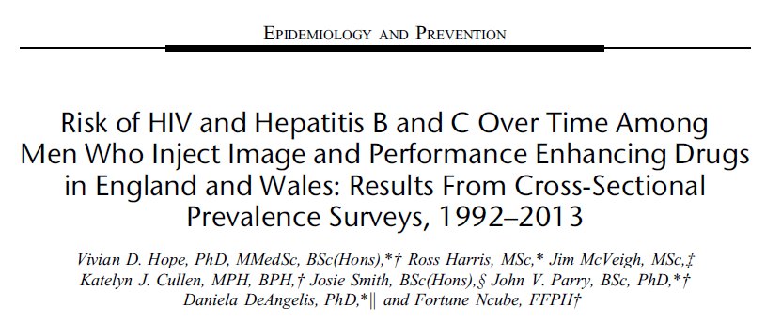

Slide 4
Presentation outline
Demographics ✓
Behaviours ✓
Harms
BBV, SSTI ✓
Psychological, Trauma ×
Prevalence ×
Trends ?

Slide 5
Needle Exchange Surveillance Initiative (NESI)
Since 2008-09, 2-yearly, cross-sectional, nationally representative survey of ~ 2500 PWID recruited from IEP sites
Majority are recent injectors i.e. Last 6-months

Slide 6
IPED users participating in NESI 2008 to 2014

Slide 7
IPED users participating in NESI 2008 to 2016

Slide 8
IPED users participating in NESI 2008 to 2016

Slide 9
IPED users participating in NESI 2008 to 2018: projected
2015-16
2017-18

Slide 10
IPED users in NESI, 2008-2016
N=268
221: IPED without heroin
47: IPED & Heroin
Cornford C.S., Kean J. & Nash A. (2014) Anabolic–androgenic steroids and heroin use: a qualitative study exploring the connection. International Journal of Drug Policy 25 (5), 928–930.

Slide 11
IPED users participating in NESI, 2008-2016: demographics
Base: n=221 | n, %
Male | 214, 96.8%
<=25 years | 51, 23.1%
26-30 years | 61, 27.6%
31-35 years | 46, 20.8%
>35 years | 63, 28.5%
Prison in last 6 months | 4, 1.8%
Average (mean) age first injected | 25.9 years
Average (mean) time since onset of injecting | 5.8 years

Slide 12
IPED users participating in NESI by Healthboard, 2008-2016

Slide 13
IPED users participating in NESI, 2008-2016: drug use

Slide 14
IPED users participating in NESI, 2008-2016: drug use
Other drugs injected:
Cocaine, 4/221 = 1.8%
Speed, 2/221 = 0.9%

Slide 15
IPED users participating in NESI, 2008-2016: behaviours
Base: n=221 | n, %
Injecting frequency
Daily or more | 20, 9.0%
Weekly or less | 201, 90.9%
N/S sharing
Never | 213, 96.4%
In the past | 7, 3.2%
Number of times re-used N/S before discarding
Never | 209, 94.5%
Once or twice | 8, 3.5%

Slide 16
IPED users participating in NESI, 2008-2016: BBV testing / vaccination

Slide 17
IPED users participating in NESI, 2008-2016: BBV testing / vaccination

Slide 18
IPED users participating in NESI, 2008-2016: HCV prevalence
Notes:
7% (n=15) of IPED users tested positive for HCV antibodies.
Evidence of recent infection in 2 cases i.e. Antibody negative, PCR positive. Both cases from most recent sweep (2015-16).

Slide 19
IPED users participating in NESI, 2008-2016: HCV prevalence / awareness of infection
Notes:
Two-thirds (n=10) unaware of their HCV infection.

Slide 20
IPED users participating in NESI, 2011-2016: HIV / HBV* prevalence
Notes:
The 1 positive anti-HBc case was surface antigen negative.

Slide 21
IPED users participating in NESI, 2015-2016: Skin and soft tissue infections (ever)

Slide 22
Comparing IPED users recruited from IEPs in Scotland vs. Eng/Wales
 | NESI (n=221) | Hope et al, 2013 (n=395)
Median age | 35 years | 28 years
Commenced IPED use <5years | 62% | 36%
Sharing N/S | 3% | 9%
HBV vaccination uptake | 26% | 23%
HIV test | 16% (35%) | 31%
HCV test | 14% (29%) | 22%
HCV antibodies | 7.0% | 5.5% (4.7%)
HIV antibodies | 0.0% | 1.5% (0.8%)

Slide 23
Strengths / weaknesses
Strengths
One of the largest studies, to date, of BBV among IPED users
Use of finger –prick dry blood spot (DBS) testing to detect antibodies to HIV and HCV
Weaknesses
Recruitment sites (IEP) / generalisability
Sample size, limited power
Limited range of harms

Slide 24
Key messages
The number of IPED users attending IEP services in Scotland is likely to be increasing
Levels of risk behaviour are modest, but do exist
Recent BBV vaccination and testing among IPED users is low in comparison to other PWID
HCV prevalence is low overall, but potentially increasing
Awareness of HCV infection is low
IPED users attending IEP in Scotland share similarities to compatriots elsewhere in UK, but differences exist.

Slide 25
Thanks for listening!
Andrew McAuley
Senior Epidemiologist, BBV/STI/VPD Group
Health Protection Scotland, Meridian Court, 5 Cadogan Street,
Glasgow, G2 6QE
and
Senior Research Fellow, School of Health & Life Sciences
Glasgow Caledonian University, Cowcaddens Road, Glasgow,
G4 0BA
phone: 0141 282 2279 email: andrew.mcauley@nhs.net

